Slide 1


HV Tower Monitoring
Failure detection with Faster R-CNN

Slide 2
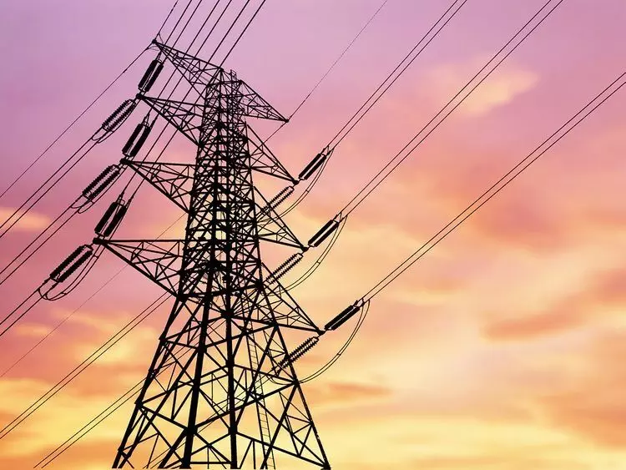
Agenda
Business Understanding
Data Understanding
Data Preparation
Modeling
Results & Evaluation
Demo
Alternative Models
Lessons Learned
Next Steps
Literature Study

Slide 3
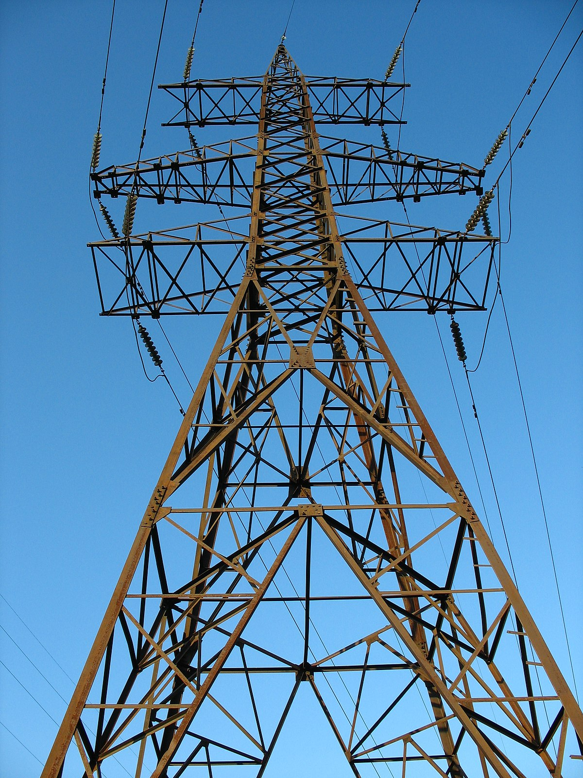

Business understanding
Objective:
Develop a computer vision model to detect rust or corrosion on drone-captured images of towers.
Goals:
Automate the detection of corrosion to improve maintenance efficiency.
Provide health index for each tower based on the severity of detected rust.
Enable data-driven decision-making for tower maintenance.
Business Needs:
Reduce manual inspection time and labor costs associated with tower maintenance.
Enhance the accuracy and reliability of corrosion detection.
Minimize maintenance costs by timely identifying towers that need repairs.
Improve safety by preventing structural failures due to undetected corrosion.

Slide 4
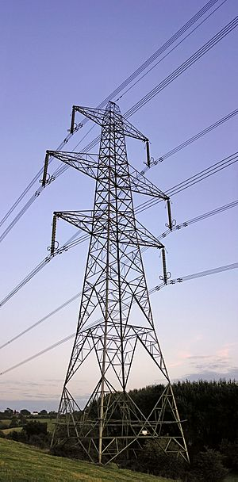
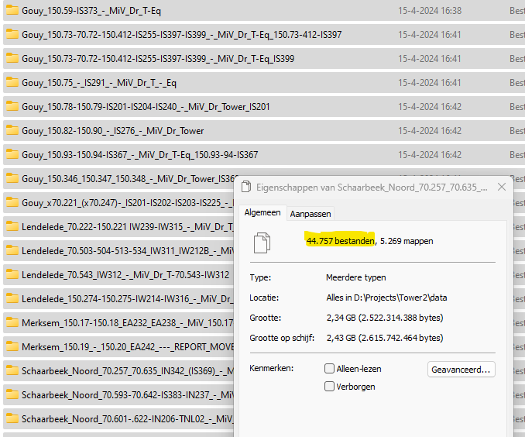
Data Understanding
Data Collection:
Source: High-resolution images captured by drones of various towers.
Types of Data:
Image Data: Photos of towers showing varying levels of corrosion.
Metadata: Information about the images such as location, bounding boxes and labels.
Volume: Large dataset comprising thousands of images collected from multiple inspections over time.

Slide 5
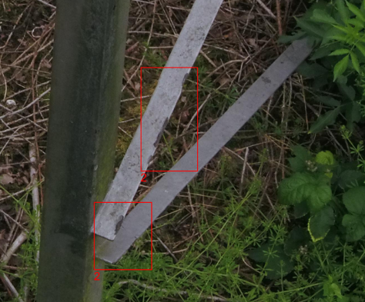
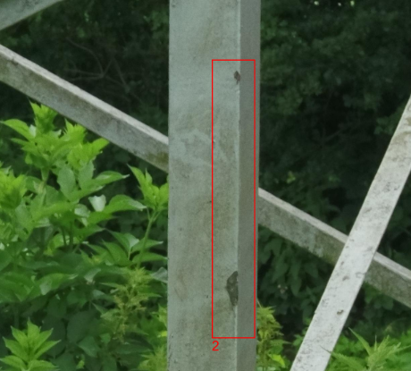
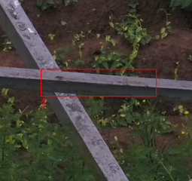
Data Preparation
Data Labeling on patches of 512x 512:
Initial Annotations: The images were initially annotated by an AI program from an external company. These annotations were found to be imprecise and not completely correct.
Manual Corrections: An asset manager from Elia was asked to manually correct the labels. However, this effort was still not sufficient to meet the required precision.
Final Labeling Process: Our team decided to label the annotations ourselves using Label Studio to ensure accuracy and consistency.

Slide 6
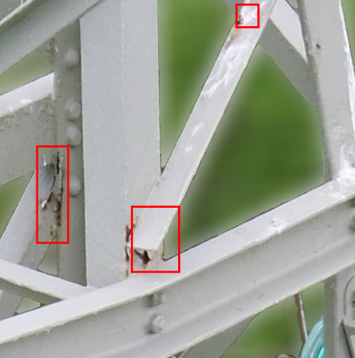
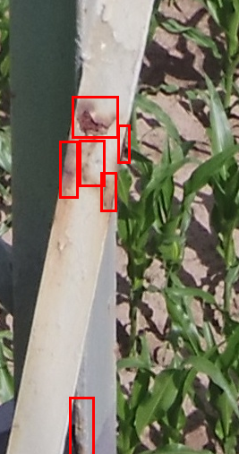
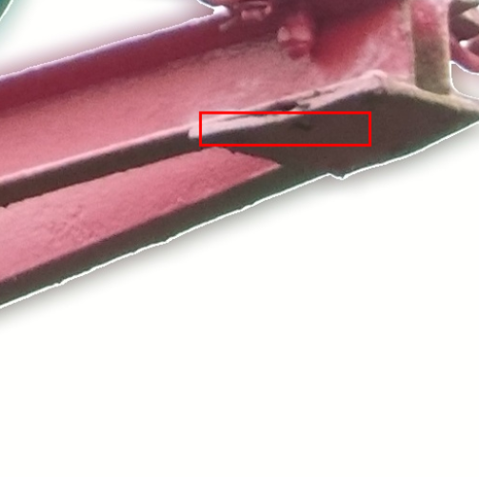
Data Preparation
Labeling by Asset Manager
Labeling Project Team
Demo: Label studio Open Source Data Labeling Platform

Slide 7
Agenda
Business Understanding
Data Understanding
Data Preparation
Modeling
Results & Evaluation
Demo
Alternative Models
Lessons Learned
Next Steps
Literature Study

Slide 8
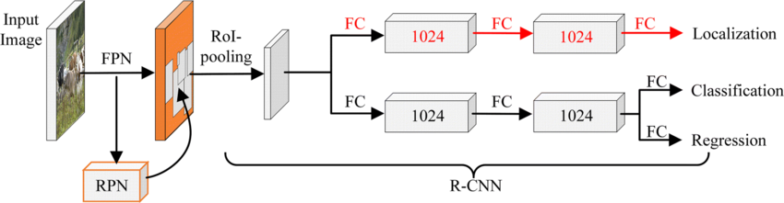
Modeling
Model Selection: Faster R-CNN ResNet-50 FPN
Model Type: Faster R-CNN (Region-based Convolutional Neural Network)
Backbone Network: ResNet (Residual Network)
Pre-trained Dataset: COCO (Common Objects in Context)
Reasons for Choosing Faster R-CNN with ResNet:
High Accuracy: Known for superior performance in object detection tasks.
Feature Extraction: ResNet effectively extracts high-level features due to its deep architecture and skip connections.
Pre-trained Weights: Leveraging the COCO dataset helps in transferring learned features to the corrosion detection task.
Notes:
The image depicts the architecture of a Faster R-CNN model with ResNet-50 and Feature Pyramid Network (FPN). Let's break down each component of this architecture:
Input Image: The process begins with an input image that is fed into the network.
Feature Pyramid Network (FPN):
The input image passes through the FPN, which generates feature maps at different scales. FPNs are used to enhance the feature extraction capability, especially for detecting objects at different scales.
Region Proposal Network (RPN):
The RPN takes the feature maps from the FPN and proposes regions of interest (RoIs) that potentially contain objects. This involves generating anchor boxes and scoring them based on the likelihood of containing an object.
RoI Pooling:
The proposed RoIs are then fed into the RoI pooling layer, which extracts a fixed-size feature map for each RoI, irrespective of the size of the proposed region.
Fully Connected (FC) Layers:
These feature maps are passed through a series of fully connected layers to perform further processing. The FC layers serve different purposes:
Localization: Two fully connected layers (with 1024 units each) are used to predict the bounding box coordinates for the objects within the proposed regions.
Classification and Regression: Another set of fully connected layers is used for object classification (to identify what the object is) and regression (to fine-tune the bounding box coordinates).
Outputs:
The final output includes the localization of objects (bounding box coordinates), classification (the type of object), and regression (refinement of the bounding box).
This Faster R-CNN architecture effectively combines region proposal and object detection into a single, efficient network, utilizing ResNet-50 for deep feature extraction and FPN for multi-scale feature maps, leading to robust object detection performance.

Slide 9
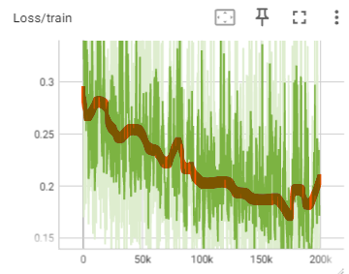
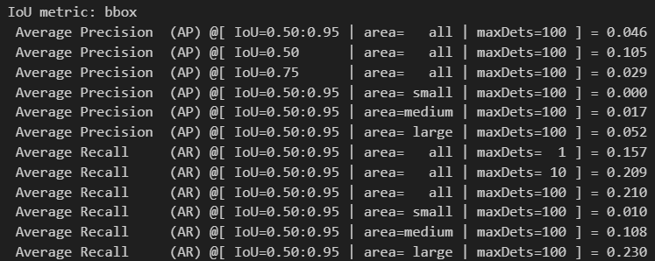
Initial Evaluation
+/- 30.000 bounding boxes, 20 epochs, initial LR = 0,001, duration 3 hours → AP 10% IoU 50%

Slide 10
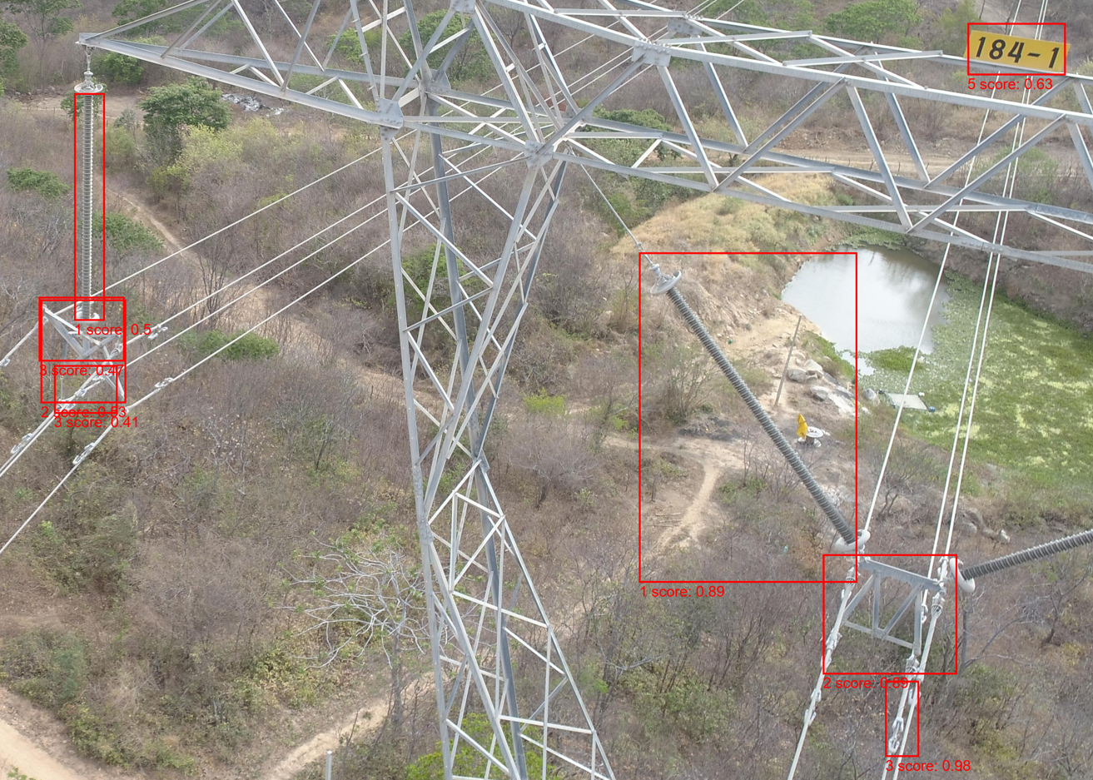
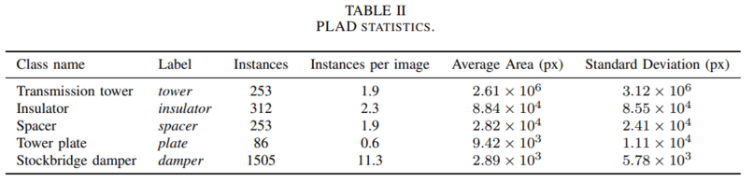
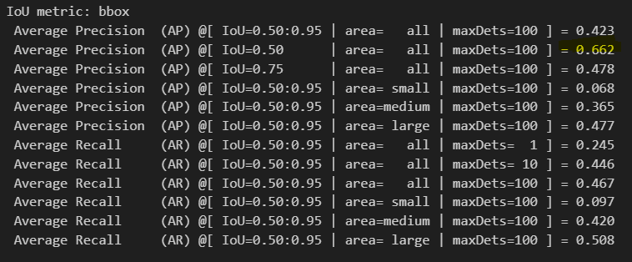
Evaluation with different dataset
Same ResNet model, another dataset (PLAD) with limited number of images (133)
Component detection instead of rust detection Gave good results ! AP → 66% IoU 50%
So, our ResNet model worked with high enough resolution
https://github.com/andreluizbvs/PLAD?tab=readme-ov-file

Slide 11
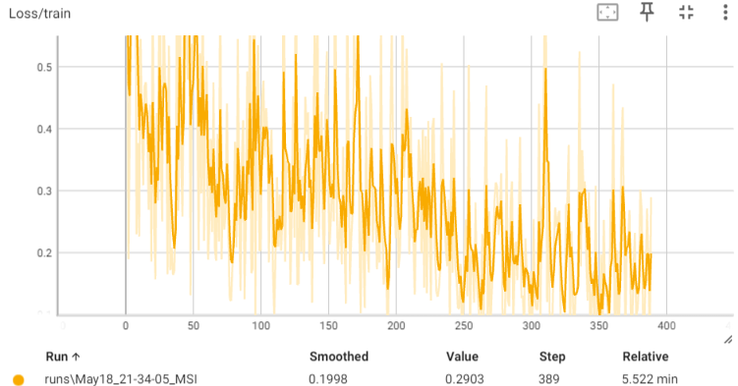
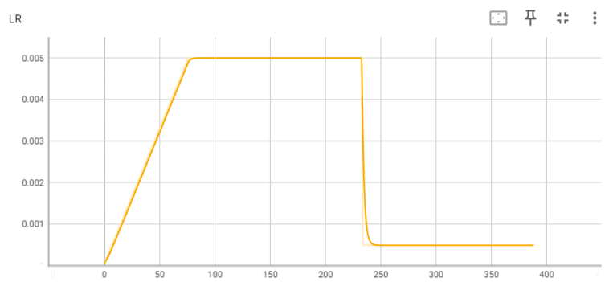
Final Evaluation
Some Figures
+/- 100 patches (512x512)
+/- 300 bounding boxes
Stabilization after 5 epochs
Initial learning rate: 0.005
Loss curve Training
Evolution Learning rate

Slide 12
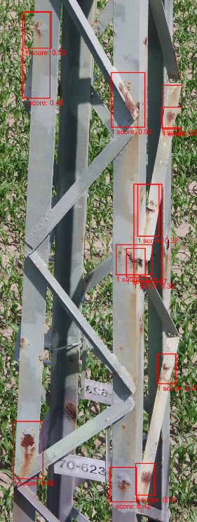
Final Evaluation
Illustration: photo from test set
AP 62% IoU 50%
KPI | IoU | Area | Value
Average Precision | 0.50:0.95 | All | 0.255
Average Precision | 0.50 | All | 0.619
Average Precision | 0.75 | All | 0.128
Average Precision | 0.50:0.95 | Small | 0.243
Average Precision | 0.50:0.95 | Medium | 0.268
Average Precision | 0.50:0.95 | Large | 0.291
Average Recall | 0.50:0.95 | All | 0.145
Average Recall | 0.50:0.95 | All | 0.372
Average Recall | 0.50:0.95 | All | 0.379
Average Recall | 0.50:0.95 | Small | 0.342
Average Recall | 0.50:0.95 | Medium | 0.391
Average Recall | 0.50:0.95 | Large | 0.388

Slide 13
alternative models
OWLv2
Model Type: OWLv2
Architecture: Transformer-based backbone
Zero-shot text-conditioned object detection model
Multi-modal backbone: uses CLIP (Contrastive Language-Image Pre-training) with a ViT-like Transformer for visual features and a causal language model for text features
Key features:
Can detect objects in images without manually annotated bounding boxes
Can use text queries to detect specific objects
GPT4o
Multimodal AI model that can comprehend text, image, video, and audio inputs
Advanced image recognition capabilities enable object detection

Slide 14
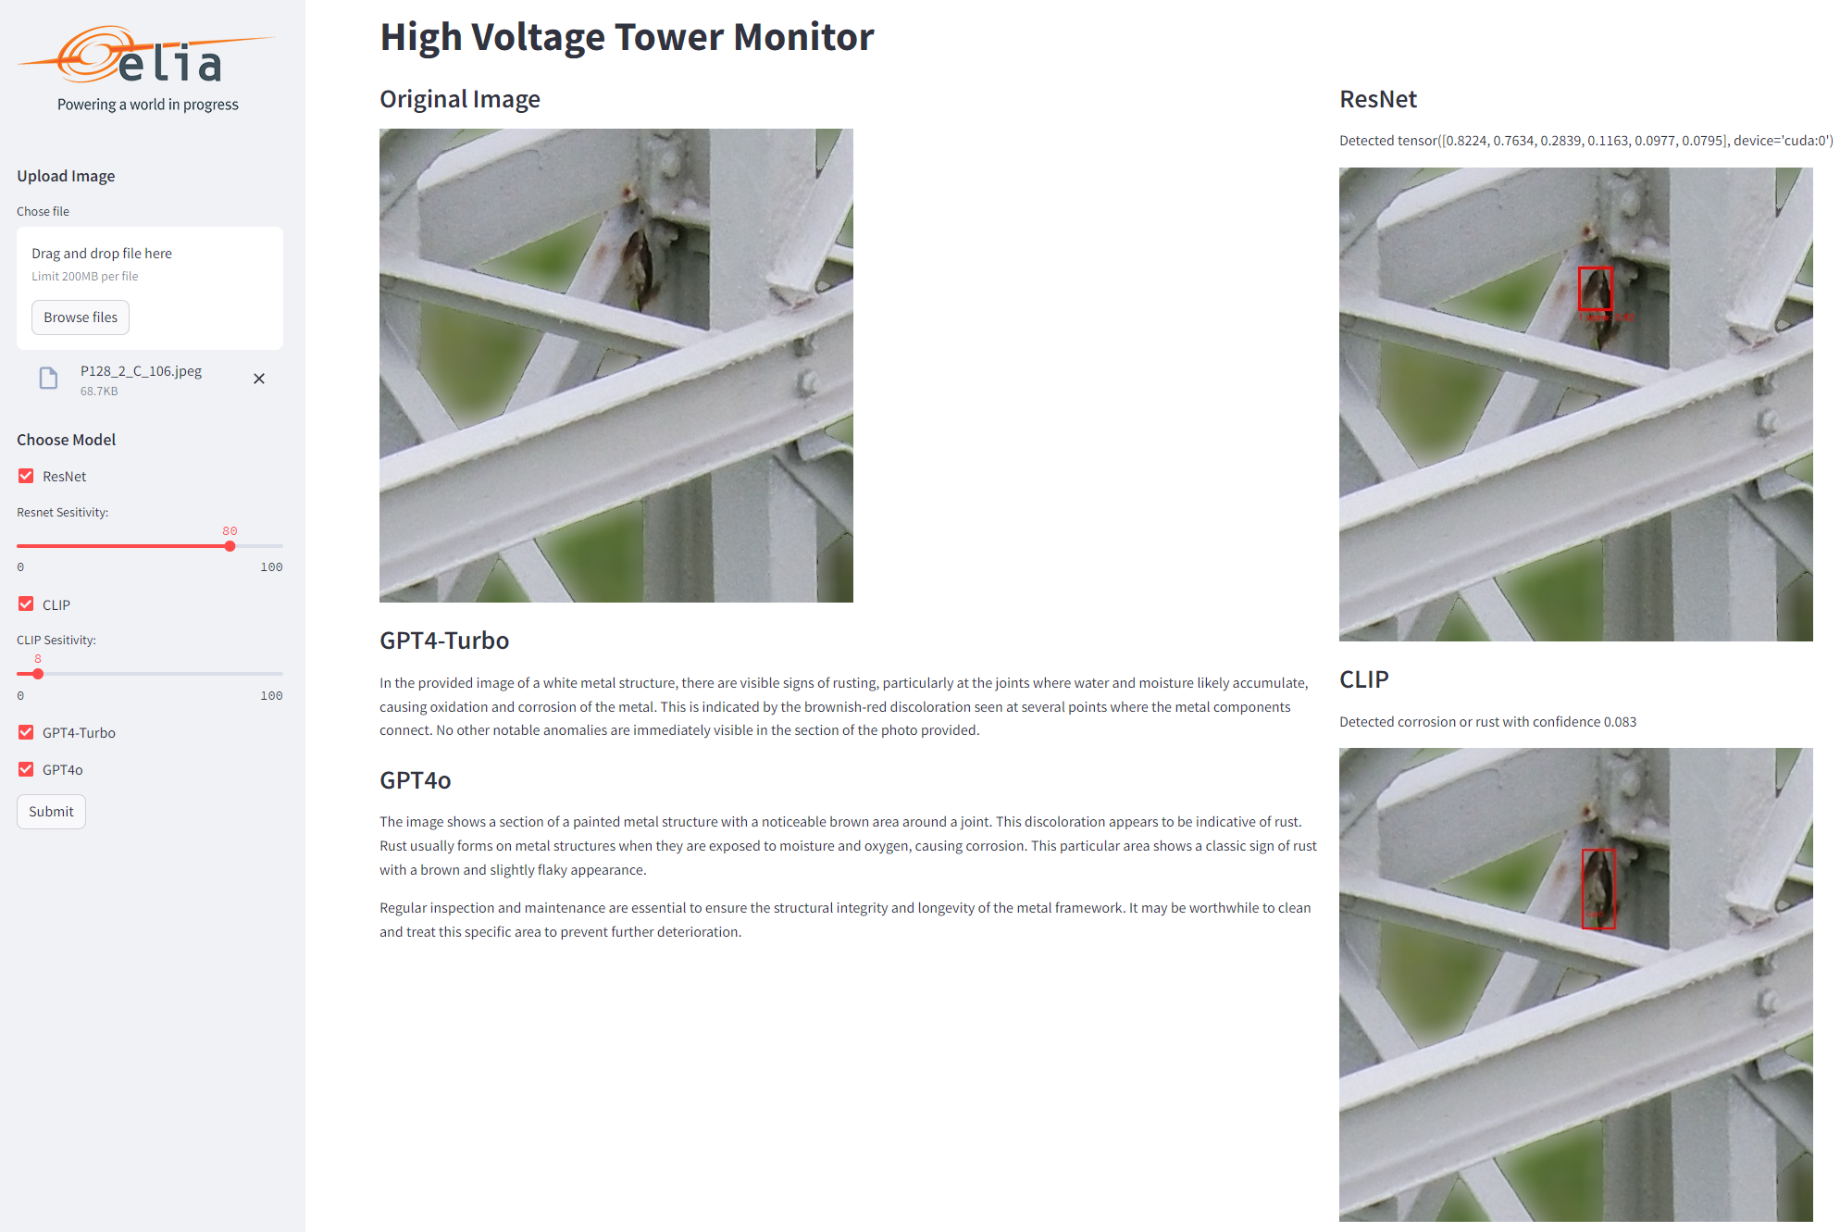
7. Demo

Slide 15
Agenda
Business Understanding
Data Understanding
Data Preparation
Modeling
Results & Evaluation
Demo
Alternative Models
Lessons Learned
Next Steps
Literature Study

Slide 16
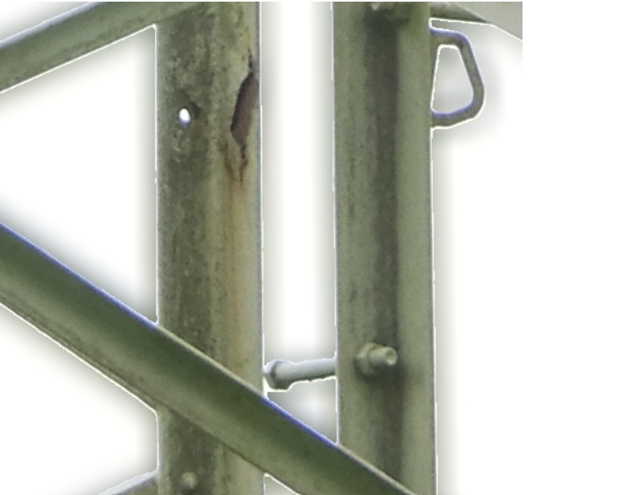
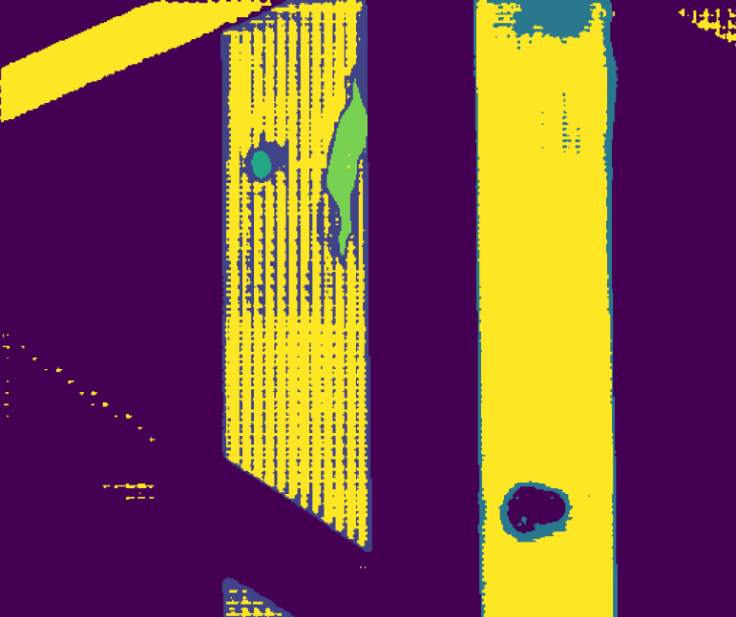
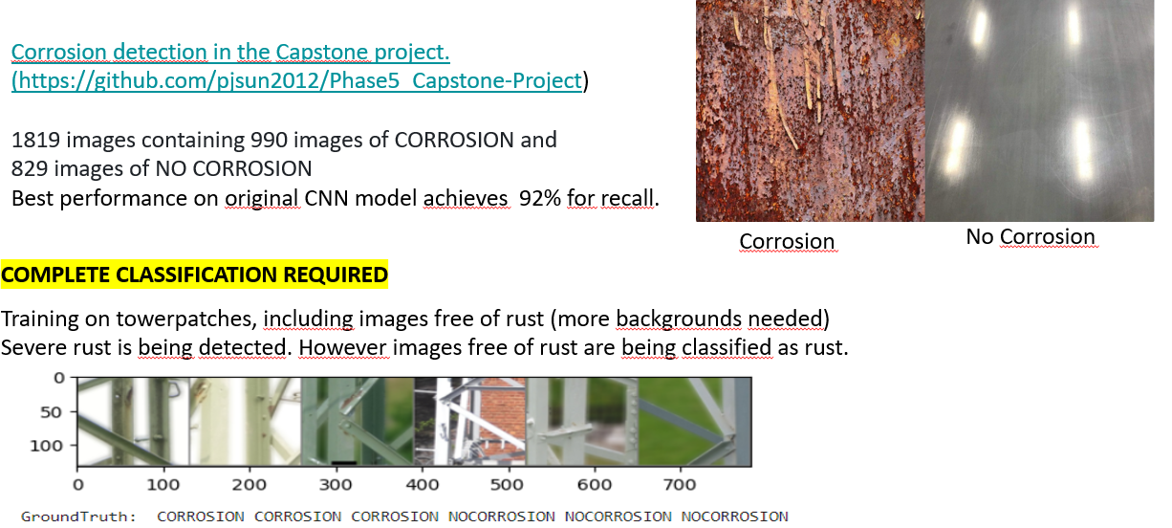
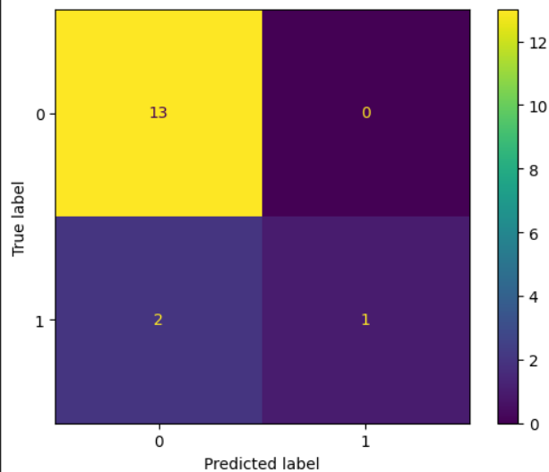
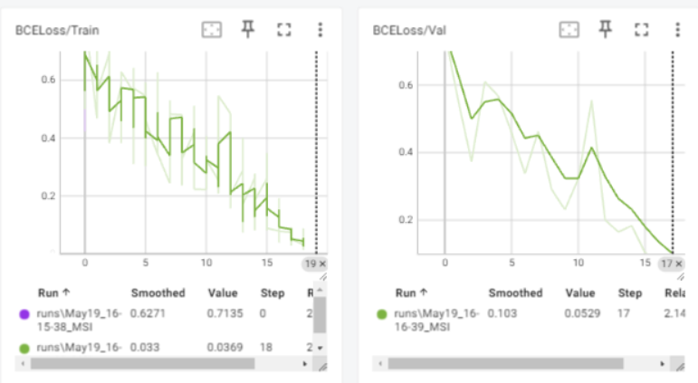
alternative models
SAM: state of the art SEGMENTATION model
https://replicate.com/idea-research/ram-grounded-sam
CLASSIFICATION: plan B
1
1

Slide 17
Lessons LEarned
Data quality & differentiation is everything, garbage in is garbage out
Bounding boxes need to be precise and accurate
Different levels of rust is a challenge
A good model can be trained on several datasets
There are many studies / papers on internet on similar subjects

Slide 18
Next Steps
Integration with maintenance decision support systems
Continuous improvement based on feedback and additional data
Performance comparison between CLIP and ResNet model for a specific IoU (0.5)
Detection of unhealthy objects (e.g. isolator with missing components, …)
Use of more diverse dataset (e.g. different backgrounds) and further application of data augmentation
Alternative models (Yolo, SSD) and methods (fine-grained rust classification, segmentation: labor intensive )

Slide 19
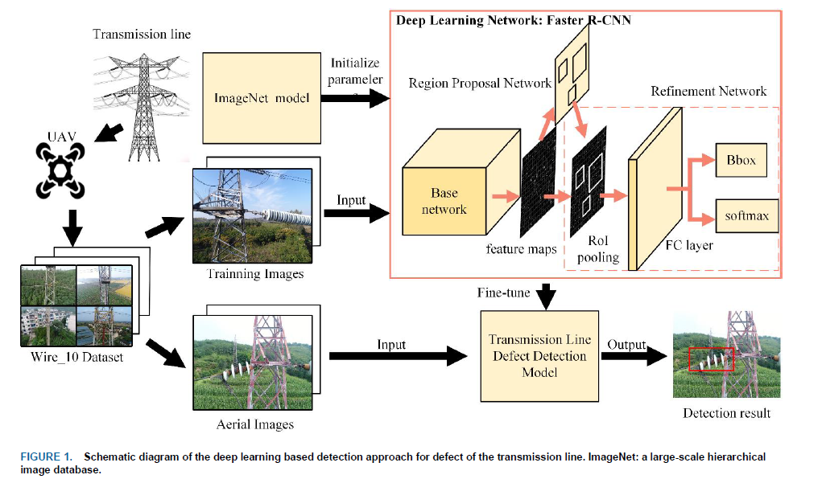
Literature Study
A comparison of Deep Learning techniques for Corrosion Detection (Tom Bolton, Julian Bass and Tarek Gaber) (https://link.springer.com/chapter/10,1007/978-3-031-20601-6_18)
Huge amount of data needed plus oracle
Redefines the problem as a classification problem of images - 4 classes
ResNet and transfer learning come to promising results with LR of 0,0001.
Precision, recall and F1 are 0,98. Adam optimizer.
Detection and evaluation method of transmission line defects based on deep learning. (Huagang Liang, Feb. 2020. IEEE access) Faster R-CNN model is used to detect 8 defects and foreign body. (source: Wire_10 dataset (8000 images)). Map reported is 91,1 %
https://ieeexplore.ieee.org/document/9001041

Slide 20

?

Slide 21
Appendix: links & references
Roboflow
Article of Zhitong Jia
Corrosion Image DataSet for Automated Scientific Assessment of Materials
Comparison of Deep Learning Techniques for Corrosion Detection
STN PLAD
Faster R-CNN vs YOLO vs SSD — Object Detection Algorithms
R-CNN, Fast R-CNN, Faster R-CNN, YOLO — Object Detection Algorithms
De Complete Gids voor Objectdetectie: Een Introductie tot Detectie in 2024
Segmentation vs Detection vs Classification in Computer Vision: A Comparative Analysis
Mean Average Precision (mAP) Explained
Segment Anything
Segment Anything | Meta AI

Slide 22
Appendix PLAD dataset
@INPROCEEDINGS{vieiraesilva2021stn,
author={{Vieira-e-Silva}, André Luiz Buarque and de Castro Felix, Heitor and de Menezes Chaves, Thiago and Simões, Francisco Paulo Magalhães and Teichrieb, Veronica and dos Santos, Michel Mozinho and da Cunha Santiago, Hemir and Sgotti, Virginia Adélia Cordeiro and Neto, Henrique Baptista Duffles Teixeira Lott},
booktitle={2021 34th SIBGRAPI Conference on Graphics, Patterns and Images (SIBGRAPI)},
title={STN PLAD: A Dataset for Multi-Size Power Line Assets Detection in High-Resolution UAV Images},
year={2021},
pages={215-222},
doi={10.1109/SIBGRAPI54419.2021.00037}

